Slide 1
Lecture 4
Pointers to: pointers; arrays and structures.

Slide 2
Pointers to pointers
A pointer can also pointer to another pointer which in turn pointers to a “standard” variable:
int i=3; // an integer variable int *j; // a pointer int **k; // a pointer to a pointer (double pointer)
j=&i; //line 1 (assigned address of an integer)
k=&j; //line 2 (assigned the address of a pointer)

Slide 3
Examples
What is output of the following statements
printf(“%d”, **k);
printf(“%p”, *k); printf(“%d”,*j); printf(“%d”,i);
Assume the following: i = 5, j = &I; k = &j

Slide 4
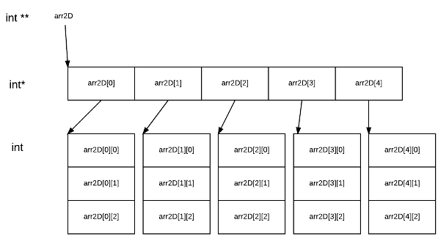
2 D Array
A 2_D array is essentially :
an arrays of pointers
like 1_d arrays each element can be accessed using subscripts or pointers / double pointers

Slide 5
Array of pointers
A 2_D array is an arrays of pointers and like 1_d arrays each elements can be accessed using subscripts notation or pointers / double pointer notation (Note: I will not expect you to always use pointer notation)
2_D array of integers:
int matrix[3][4]; //declare 2_D array
Access individual elements using subscript notation:
printf(“ value of row 2 col 2 is %d”, matrix[1][1]);
Access elements using pointer notation
printf(“ value of row 2 col 2 is %d”, *(*(matrix + 1) + 1));
*(matrix + 1)
*(*(matrix + 1) +1)
Explain clearly how the pointer notation prints row 2 col ?

Slide 6
Manipulate 2_D array
To access each element you need to use nested for loops; consider a 3x3 matrix
To print each value
for (row = 0; row<3; row++)
for (col = 0; col <3; col++ )
printf(“matrix[row][col] “); // can also use pointer arithmetic
How would you determine the result of the addition of two matrices. (be aware you must understand what is matrix addition )

Slide 7
Matrix multiplication
How would you perform matrix multiplication of two matrices?
The following link describes how to multiply two matrices: matrix multiplication
Refer to the 3x3 image file on web courses

Slide 8
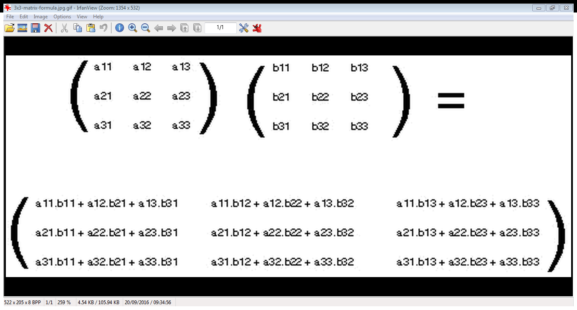

Slide 9
3 For loop: matrix multiplication
Generic c code for multiplying 2 matrices that are already contain value :
for (c = 0; c < m; c++) {
for (d = 0; d < q; d++) {
for (k = 0; k < p; k++) {
sum = sum + first[c][k]*second[k][d];
}
multiply[c][d] = sum;
sum = 0;
}
}
Where m = number of rows for matrix 1; p is number of cols for matrix 1 and number of rows matrix 2 ( must be the same); q = number of cols matrix 2

Slide 10
Array of string pointers
If you wanted to create an array to store all the months [strings] of the year you could
Create a 2_d character array: char month[12][10]
Why would this be inefficient?
Another option is to create an array of characters pointers: char *months[12]
Each row is then treated an a char * (string)
Remember you must assign memory for each using char *[1] = “January”
Consider the following program

Slide 11
Display months (array of char * )
#include <stdio.h>
void main()
{
/* Define an array of strings */
char *months[12] = {"January", "February", "March", "April", "May", "June", "July", "August", "September", "October", "November", "December" };
int i;
/* Display the months of the year using subscripts */
printf("The months of the year are:\n\n");
for(i = 0; i< 12; i++)
printf("%s\n", months[i]);
/* Display the months of the year using pointer arithmetic */
printf("The months of the year are:\n\n");
for(i = 0; i< 12; i++)
printf("%s\n", *(months +i));
}

Slide 12
Structures (a record)
A structure is a heterogeneous data structure; e.g.
struct personnel /* Structure template for employee */
{
int number;
char surname[26];
char initial;
char dob [8];
int dept;
char date_joined [8];
};
// declare a variable for a structure
struct personnel person;

Slide 13
Nested structures and pointers
struct date /* Structure template for a date */
{
int day;
int month;
int year;
};
struct personnel /* Structure template for employee */
{
int number;
char surname[26];
char initial;
struct date dob;
int dept;
struct date joined;
};
struct personnel person; // declaring a variable to a structure
struct personnel *ptr; //declaring a pointer to a structure

Slide 14
Using structure
The following are examples of accessing fields
Using the . operator
person.surname // it’s a string (a primary field)
person.dob.day // a field of a nested structure
person.dept
Using pointer notations
ptr = &person // assign struct to a pointer
ptr -> surname;
ptr ->dob.day;

Slide 15
Passing a structure to a function
Like other data types a structure can be passed by value or by reference.
By value “ pass the structure” and by reference “a pointer to the structure”.
Do not forget to use the appropriate notation in each function (if struct use the dot operator; if prt use the ->

Slide 16
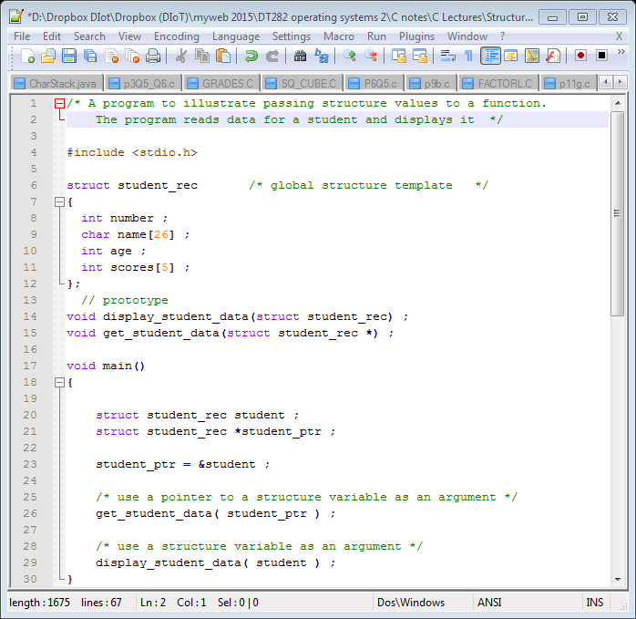
Structures to functions

Slide 17
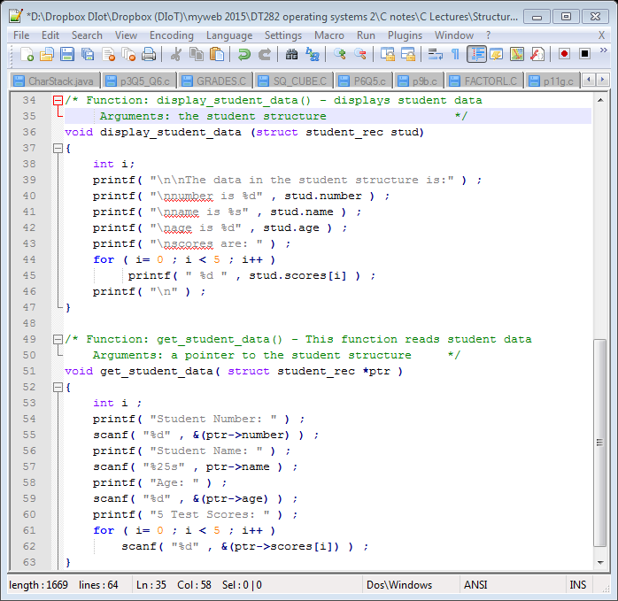

Slide 18
Array of structure
An array can also hold structures
Typedef
Typedef Struct personnel EMPLOYEE
Declare an array of structures
EMPLOYEE staff[20];
The emp.c is a program that declares an array of structures and then allows the user to
Add a record in the form a of struct
Delete a record [e.g. assign 0 to indicate empty position]
Display a record
Edit a record

Slide 19
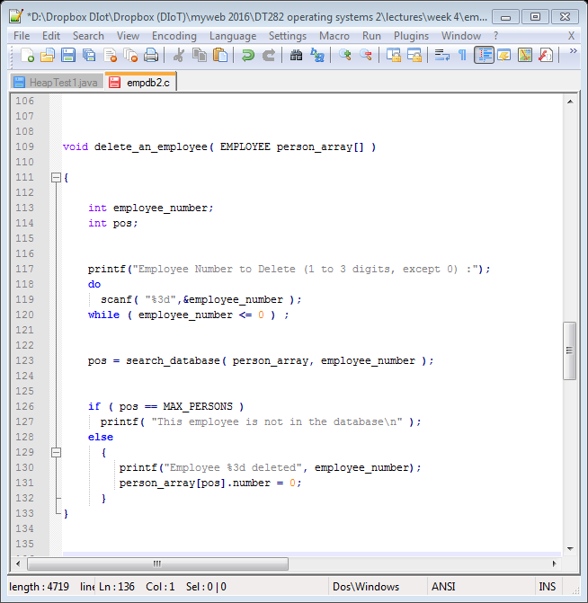
Delete function

